Slide 1
IS 635 Presentation
Team Cluelez
Artificial Intelligence
Ayush Vij
Sadan Iqbal
Madhur Ingle

Slide 2
What are we talking about?
How effective is the business?
The Introduction
What is it about?
The Live code
Monetization

Slide 3
Introduction
Our take on Cybersecurity Awareness

Slide 4
“
“Security used to be an inconvenience sometimes, but now it’s a necessity all the time.”
- Martina Navratilova

Slide 5
Cluelez
Adventurous and Educational
Portable
Ease of Interaction
Up to Date
Vaccine to Cyber Crimes

Slide 6
ICO Security Incidents in UK
Central Government
Education Sector
Finance Industry
HealthCare
Justice

Slide 7
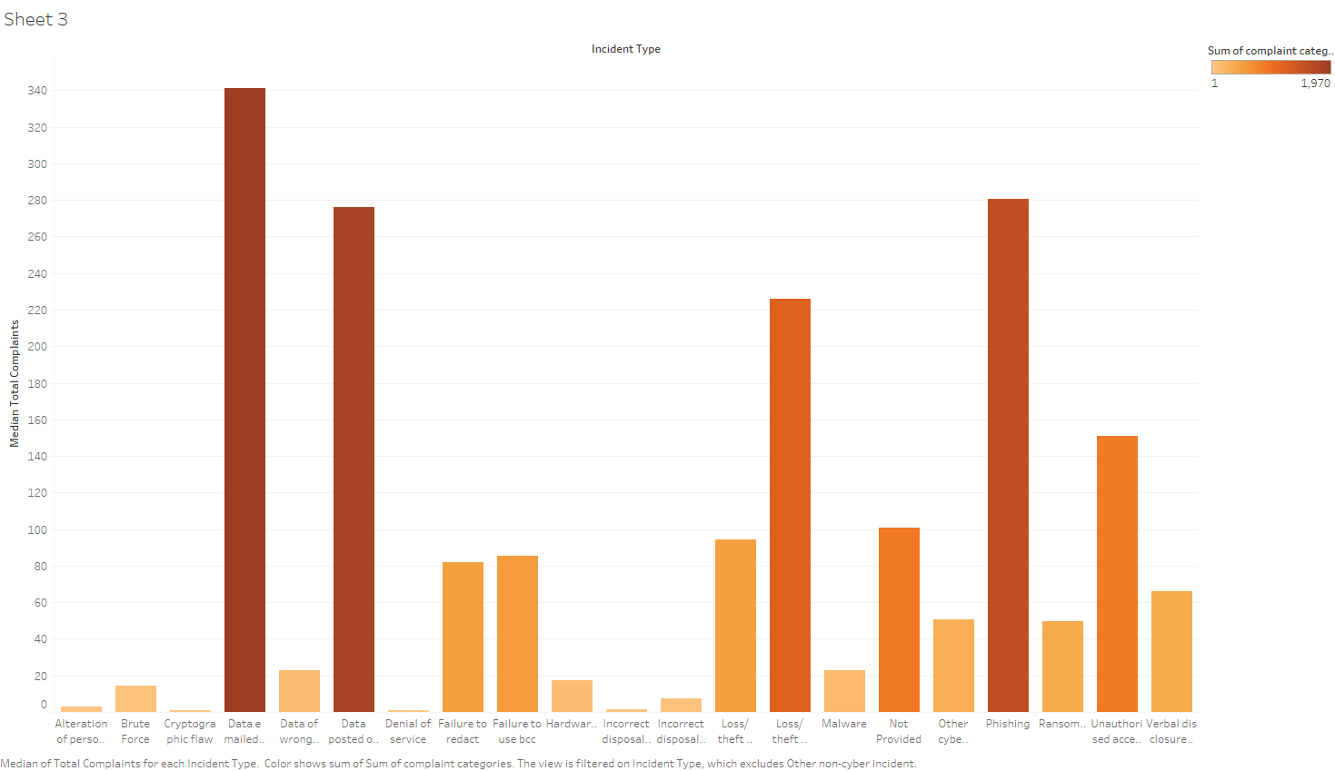

Slide 8
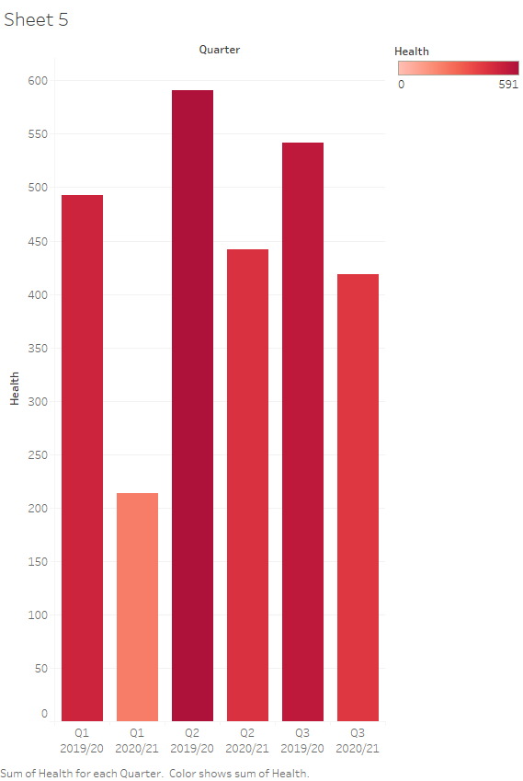

Slide 9
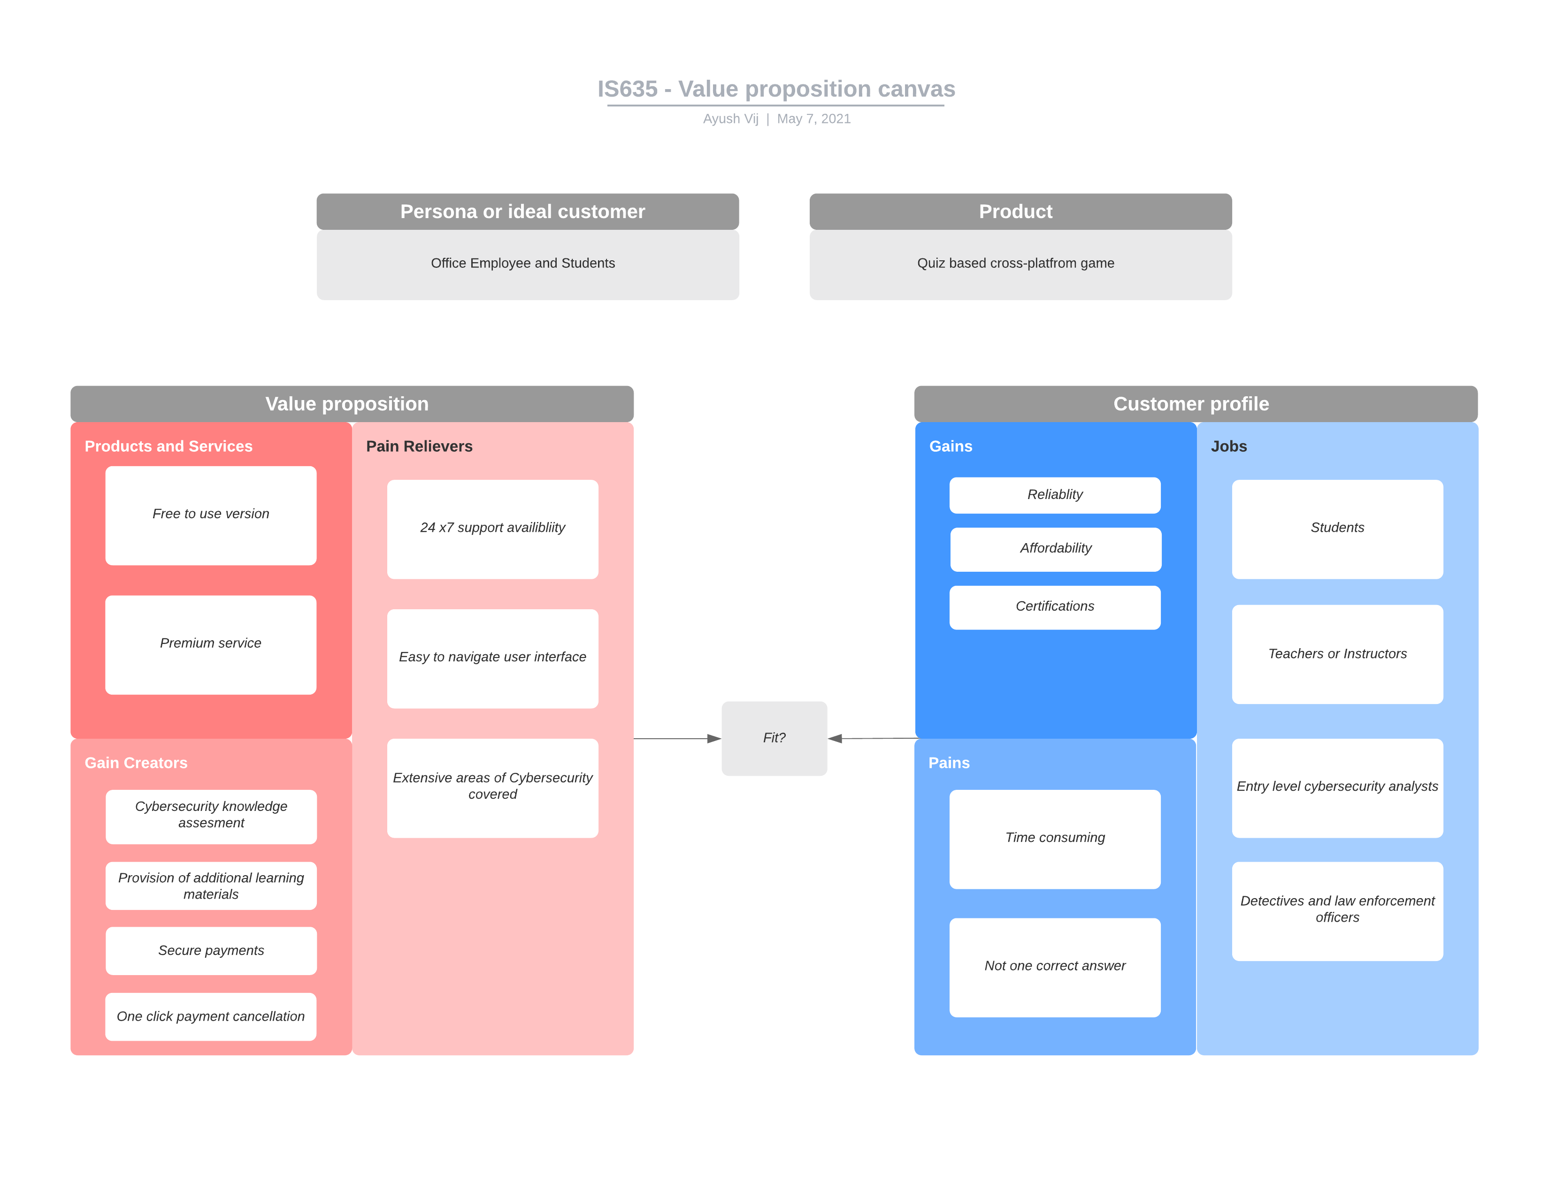

Slide 10
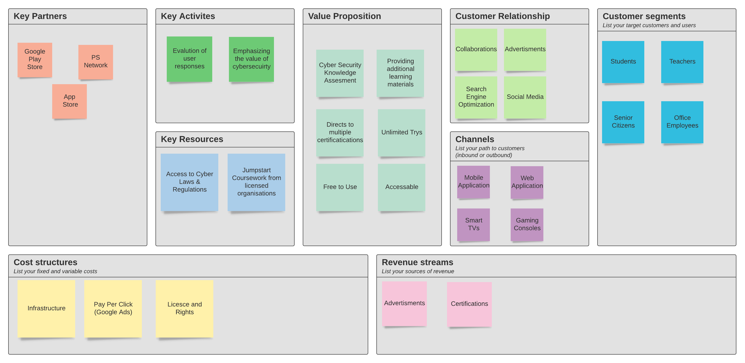

Slide 11

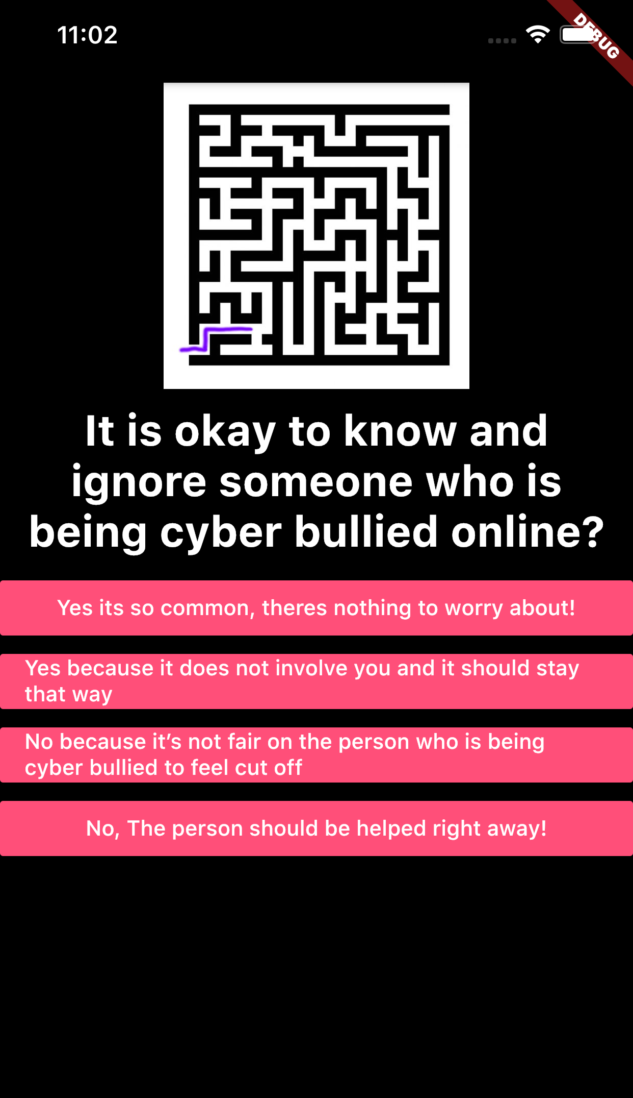
In Action
We have our vision come to life..

Slide 12
This is how the quiz page looks like..

Slide 13
Upon selecting a choice, the maze and the quiz will progress..

Slide 14
Upon selecting a choice, the maze and the quiz will progress..

Slide 15
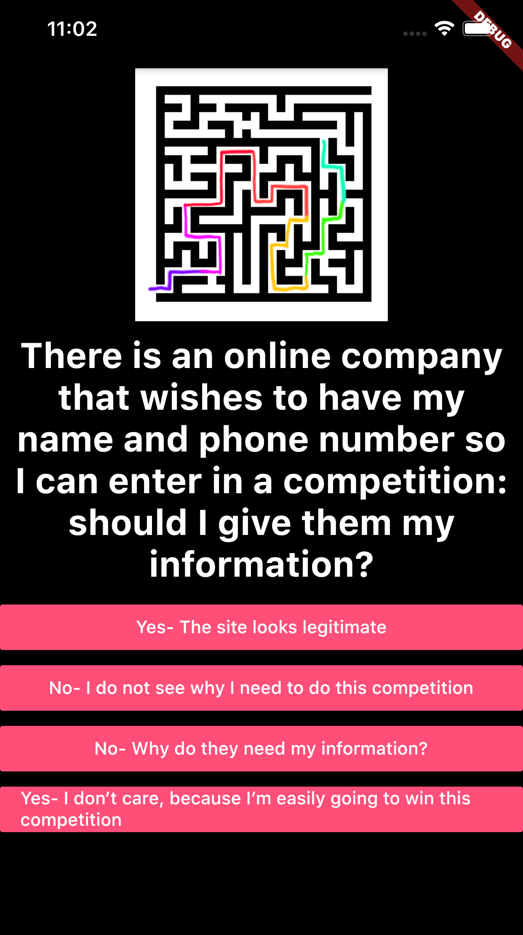
You’ll have 10 questions to answer..

Slide 16
You’ll have 10 questions to answer..

Slide 17
You’ll have 10 questions to answer..

Slide 18
You’ll have 10 questions to answer..

Slide 19
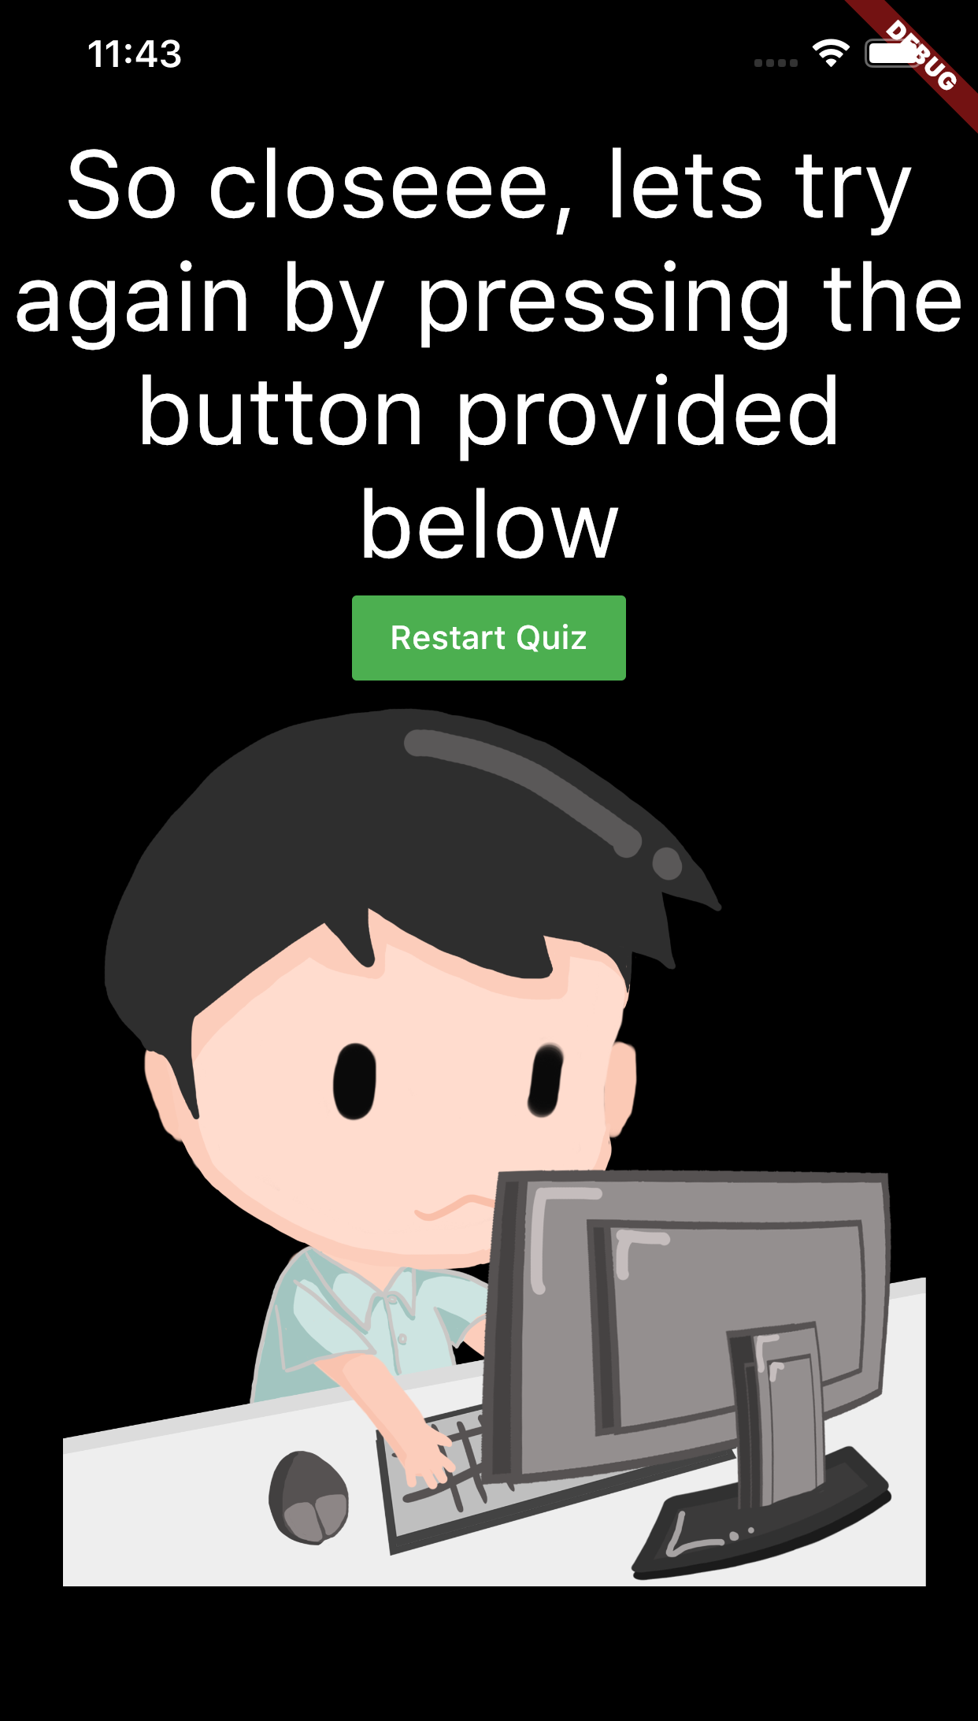
Once done, you’ll get your results and the next steps..

Slide 20
Monetization
Google Ads
Third-party platform hosting
Affiliated links

Slide 21
Thank you!
We would like to answer any questions if you have.
questions?

Slide 22
Thank you!
We would like to answer any questions if you have.
questions?

Slide 23
Thank you!
We would like to answer any questions if you have.
questions?

Slide 24
Thank you!
We would like to answer any questions if you have.
questions?

Slide 25
Thank you!
We would like to answer any questions if you have.
questions?

Slide 26
Thank you!
We would like to answer any questions if you have.
questions?

Slide 27
Thank you!
We would like to answer any questions if you have.
questions?

Slide 28
Thank you!
We would like to answer any questions if you have.
questions?

Slide 29
Thank you!
We would like to answer any questions if you have.
questions?

Slide 30
Thank you!
We would like to answer any questions if you have.
questions?

Slide 31
Thank you!
We would like to answer any questions if you have.
questions?

Slide 32
Thank you!
We would like to answer any questions if you have.
questions?

Slide 33
Thank you!
We would like to answer any questions if you have.
questions?

Slide 34
Thank you!
We would like to answer any questions if you have.
questions?

Slide 35
Thank you!
We would like to answer any questions if you have.
questions?

Slide 36
Thank you!
We would like to answer any questions if you have.
questions?

Slide 37
Thank you!
We would like to answer any questions if you have.
questions?

Slide 38
Thank you!
We would like to answer any questions if you have.
questions?

Slide 39
Thank you!
We would like to answer any questions if you have.
questions?

Slide 40
Thank you!
We would like to answer any questions if you have.
questions?

Slide 41
Thank you!
We would like to answer any questions if you have.
questions?

Slide 42
Thank you!
We would like to answer any questions if you have.
questions?

Slide 43
Thank you!
We would like to answer any questions if you have.
questions?

Slide 44
Thank you!
We would like to answer any questions if you have.
questions?

Slide 45
Thank you!
We would like to answer any questions if you have.
questions?

Slide 46
Thank you!
We would like to answer any questions if you have.
questions?

Slide 47
Thank you!
We would like to answer any questions if you have.
questions?

Slide 48
Thank you!
We would like to answer any questions if you have.
questions?

Slide 49
Thank you!
We would like to answer any questions if you have.
questions?

Slide 50
Thank you!
We would like to answer any questions if you have.
questions?

Slide 51
Thank you!
We would like to answer any questions if you have.
questions?

Slide 52
Thank you!
We would like to answer any questions if you have.
questions?

Slide 53
Thank you!
We would like to answer any questions if you have.
questions?

Slide 54
Thank you!
We would like to answer any questions if you have.
questions?

Slide 55
Thank you!
We would like to answer any questions if you have.
questions?

Slide 56
Thank you!
We would like to answer any questions if you have.
questions?

Slide 57
Thank you!
We would like to answer any questions if you have.
questions?

Slide 58
Thank you!
We would like to answer any questions if you have.
questions?

Slide 59
Thank you!
We would like to answer any questions if you have.
questions?

Slide 60
Thank you!
We would like to answer any questions if you have.
questions?

